Slide 1
Who’s Julia?

Slide 2


Why Julia?
Proclaimed faster than Python
Learning
Similar to Python
Documentation is not great

Slide 3
Benchmarking
Which time to measure
Tasks to analyze
State of machine
Certainty of correct performance

Slide 4
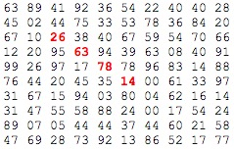
Projecteuler: problem 11
Largest product in a grid: N x N
k adjacent numbers
Benchmarking

Slide 5
Results: 2 adjacent numbers

Slide 6
Results: 5 adjacent numbers

Slide 7
Results: 10 adjacent numbers

